Slide 1
SECURE DATA HIDING IN IMAGES USING STEGNOGRAPHY
SECURE THE DATA TO PREVENT HACKERS
Presented By: Rahul Sahoo
Student Name : Rahul Sahoo
College Name : Swami Vivekananda University &
Department : B.Tech CSE

Slide 2
OUTLINE
Problem Statement
Technology used
Wow factor
End users
Result
Conclusion
Git-hub Link
Future scope

Slide 3
Problem Statement
This problem is implement a secure data hiding tool using steganography. This tool encrypt your message in a image and you can optionally use any passkey for added security. During decryption you not fill any passkey than show the message with passkey but if you put wrong message showing warning.

Slide 4
Technology used
In this Work I use –
Programming Language – Python
Library - Tkinter (For GUI), PIL (Pillow for image manipulation and resizing), OpenCV (reaing and writing image files).

Slide 5
Wow factors
Passkey Integration :
Offers an optional passkey for enhanced security, ensuring only authorized users can decrypt the message.
User-Friendly GUI :
Features an intuitive graphical user interface (GUI) built with Tkinter, making the tool accessible to all users.
Dynamic Image Handling:
Utilizes the PIL library to dynamically resize and manipulate images for a seamless user experience.
Error Handling and Feedback:
Provides robust error handling and user feedback through warning and error messages.
Integration of OpenCV:
Employs OpenCV for efficient image processing, ensuring smooth encoding and decoding of messages.

Slide 6
End users
Educational Institutions :
Students and educators in computer science and cybersecurity fields can use this tool for learning and teaching steganography concepts.
Privacy-Conscious Users :
Users who need to secure sensitive information in a way that is not easily detectable.
Developers and Researchers :
Professionals working on projects related to data security and image processing can use this tool for testing and experimentation.
General Public :
Anyone interested in experimenting with data hiding and image manipulation for personal projects or curiosity.
Data Security Enthusiasts :
Individuals interested in exploring secure methods of hiding information within images.

Slide 7
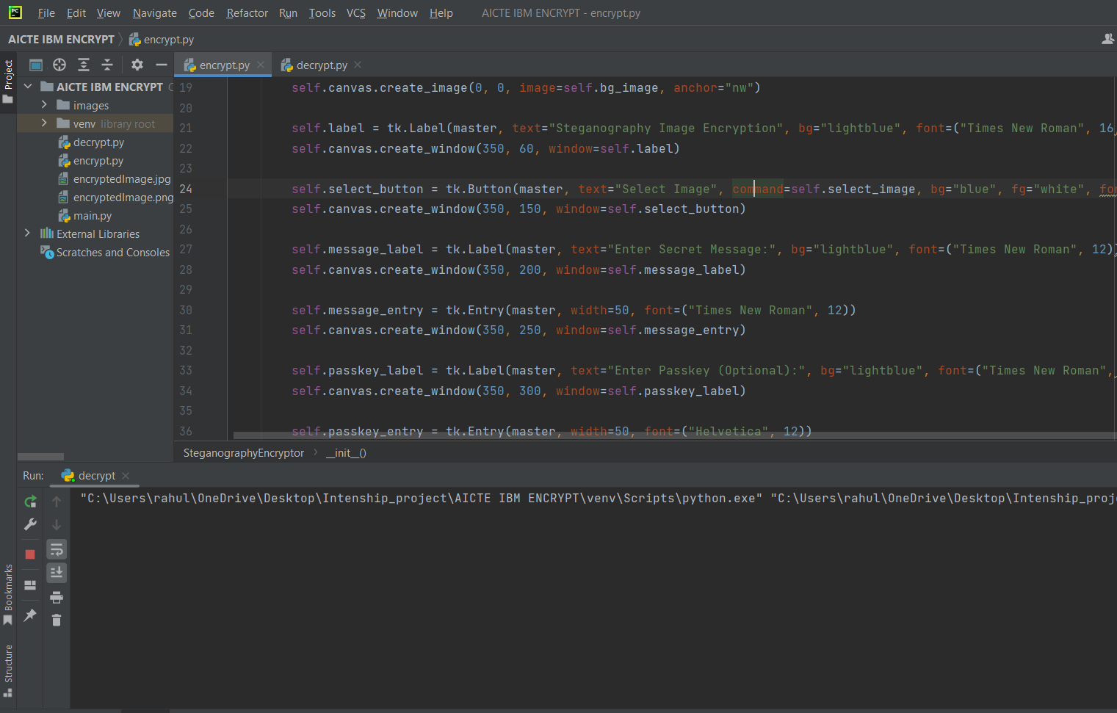
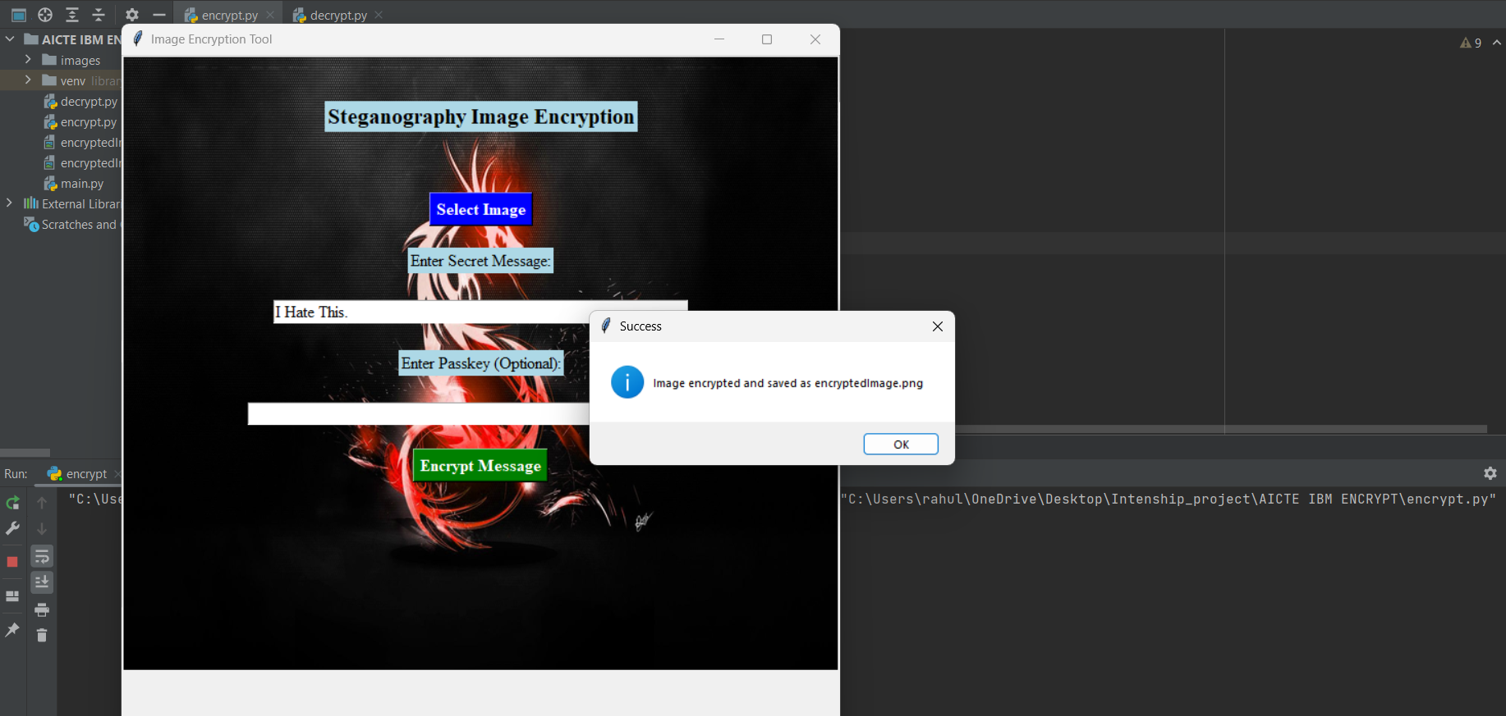
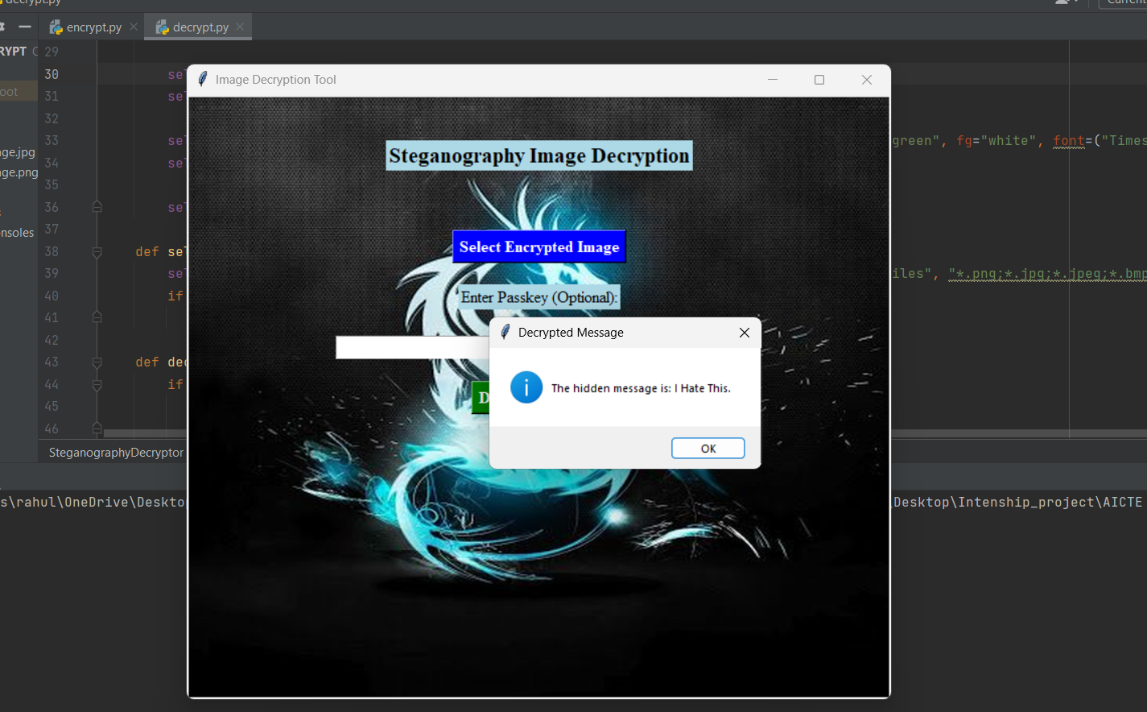
Results

Slide 8
Conclusion
Creating this project has been an immensely rewarding journey. Integrating Tkinter, PIL, and OpenCV to develop a secure data hiding tool has been both stimulating and enlightening. I'm particularly proud of the intuitive GUI and the successful implementation of the optional passkey feature, which adds an extra layer of security.
This project provided an invaluable opportunity to deepen my understanding of image processing and data security. I'm excited about the potential impact of this tool and hopeful that it will be used to securely hide and retrieve sensitive information, protecting it from unauthorized access. Overall, this journey has been a blend of learning, innovation, and satisfaction, and I'm eager to see how the project will be received.

Slide 9
GitHub Link
https://github.com/Raw-Coder-Rahul/AICTE-EDUNET-DGT

Slide 10
Future scope(optional)
Enhance the Encryption Technique
Improved the User Interface.

Slide 11
THANK YOU

